Slide 1
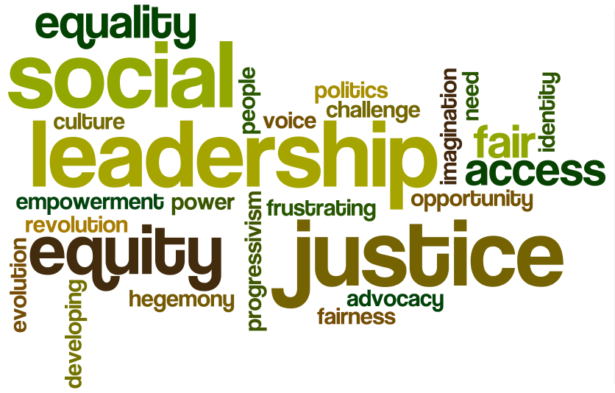
Teaching Elementary French Through the Lens of Social Justice: Initial Reactions to Piloted Activities
Sarah Glasco
sglasco@elon.edu

Slide 2
What is social justice?
“A philosophy, an approach, and actions that embody treating all people with fairness, respect, dignity, and generosity.”
(Nieto, 2010, p. 46).

Slide 3
Why Social Justice?
Link between Social Justice and World Languages
Teaching for social justice helps us to move beyond teaching languages for pragmatic and instrumental purposes.
Global Competence: “The ability to communicate with respect and cultural understanding in more than one language” (ACTFL, 2014).
Intercultural Communicative Competence: An individual can see relationships among different cultures and mediate among them (Byram, 2000).
* Slide from “Teaching World Language Topics through the Lens of Social Justice”
Cassandra Glynn, Ph.D. Concordia College, Moorhead, MN Webinar March 4, 2015

Slide 4
Why Social Justice?
Hypothesis: If students begin to connect their beginning language studies with other disciplines in a more active and engaging way through the lens of social justice, they will:
build, reinforce, and expand their knowledge of other disciplines while using new linguistic and cultural knowledge to further develop critical thinking and to solve social justice issues and thus other problems creatively;
access and evaluate information and diverse perspectives that are available through the language and its cultures;
realize at this level that they can use the language and culture to investigate, explain, and reflect on the nature of language and cultures through comparisons of their own to others as well as the relationship between the practices and perspectives and products of Francophone cultures;
use French both within and outside the classroom to interact and collaborate in the community and the world;
and finally, understand that all this aligns directly with Elon’s various missions regarding global education, inclusion, diversity, engaging with local communities, and quite simply concern for the common good.

Slide 6
Four Components of Social Justice Education (Glenn, Wesely, & Wassell citing Nieto)
1- It challenges, confronts, and disrupts misconceptions, untruths, and stereotypes that lead to structural inequality and discrimination
2- It provides all students with the resources necessary to learn to their full potential.
3- It draws on the talents and strengths that students bring to their education.
4- It creates a learning environment that promotes critical thinking and agency for social change. (Nieto, 2010)
* Slide from “Teaching World Language Topics through the Lens of Social Justice”
Cassandra Glynn, Ph.D. Concordia College, Moorhead, MN Webinar March 4, 2015

Slide 7
KEY CONCEPTS (Glenn, Wesely, & Wassell citing Wade)
“If we are to teach for and about social justice, understanding what it looks, sounds, and feels like is critical” (Wade, 2007, p. 4).
Equality
Equity
Privilege
Marginalization
Oppression
Dehumanization
* Slide from “Teaching World Language Topics through the Lens of Social Justice”
Cassandra Glynn, Ph.D. Concordia College, Moorhead, MN Webinar March 4, 2015

Slide 8
Categories of Social Justice Issues (Glenn, Wesely, & Wassell)
1. Products: Social justice issues that focus on access to and relationships with tangible and intangible resources.
2. Practices: Social justice issues that arise from how people interact.
3. Perspectives: Social justice issues stemming from attitudes and values.
* Slide from “Teaching World Language Topics through the Lens of Social Justice”
Cassandra Glynn, Ph.D. Concordia College, Moorhead, MN Webinar March 4, 2015

Slide 9
Categories of Social Justice Activities (Glenn, Wesely, & Wassell)
1. Problem-posing activities: Focus on discussion, critical inquiry, and interactive participation (Reagan & Osborn, 2002).
2. Text analysis activities: Activities with not just the written word, but also the spoken word, audio and videotape, media elements, images, etc. (Kramsch, 1993).
3. Rights and policy investigations: Explores how groups and individuals might be affected by externally-imposed rules and regulations, often in the form of policy and laws.
4. Individual experience investigations: The activities allow students to see the individual perspective in new ways through face-to-face interviews, simulations, social media, online communities, etc.
5. Reflective activities: Journaling, multicultural awareness tasks, comparisons to others, etc. Allow students to see how social justice issues affect (or don’t affect) their daily lives.
* Slide from “Teaching World Language Topics through the Lens of Social Justice”
Cassandra Glynn, Ph.D. Concordia College, Moorhead, MN Webinar March 4, 2015

Slide 10
Examples of Social Justice Activities used in 3 sections of FRE 121 (Elementary French I), Fall 2015 with the textbook Points de départ by Scullen, Pons, & Valdman
1. Chapitre préliminaire : theme> introducing yourself & the classroom
The expression il y a + classroom vocabulary: introduce students to Francophone Africa, colonialism, and poverty in Francophone Africa. Discussion in French and intro to cognates and linguistic patterns in French.
Social Justice Categories: text analysis; reflection

Slide 11
Dans la salle de classe, il y a…
Ecrivez tous les objets dans la salle de classe.
Utilisez l’expression “il y a” [there is/there are]
Par exemple:
Il y a un ordinateur.
Ensuite, comparez votre liste avec la liste d’un camarade de classe. Parlez en français!!!
Enfin, nous prononcerons tout le vocabulaire du chapitre préliminaire ensemble.

Slide 12
And then…
Students are shown a photo of a class in Mali.
I ask them: Qu’est-ce qu’il y a?
Il y a un professeur, il y a des élèves (des enfants), il y a des sacs à dos, il y a des tableaux noirs…
I ask them: Il y a un ordinateur dans cette salle de classe?
Elicit complete sentences with “il n’y a pas”
Il n’y a pas de livres, pas de cahiers…
Il n’y a pas de lecteur DVD.
Il n’y a pas de pupitres.
Il n’y a pas de chaises.
Il n’y a pas de tableau blanc.
Et ainsi de suite avec tout le vocabulaire du chapitre

Slide 13
Une salle de classe au Mali

Slide 14
Où est le Mali

Slide 15
Comment vous sentez-vous?
Students are asked how the image of the Malian school children in their classroom makes them feel.
They offer adjectives in English and their French equivalents are written on the board with the expressions “Je me sens…”. We pronounce/repeat all sentences and discuss cognates.
Je me sens... (Je suis)
Curieux/curieuse
Triste
Perplexe
Concerné(e)
Impuissant(e)
Motivé(e) à aider
Pas surpris (e)
Links for further reading:

Slide 16
L’organisme bénévole UNICEF

Slide 17
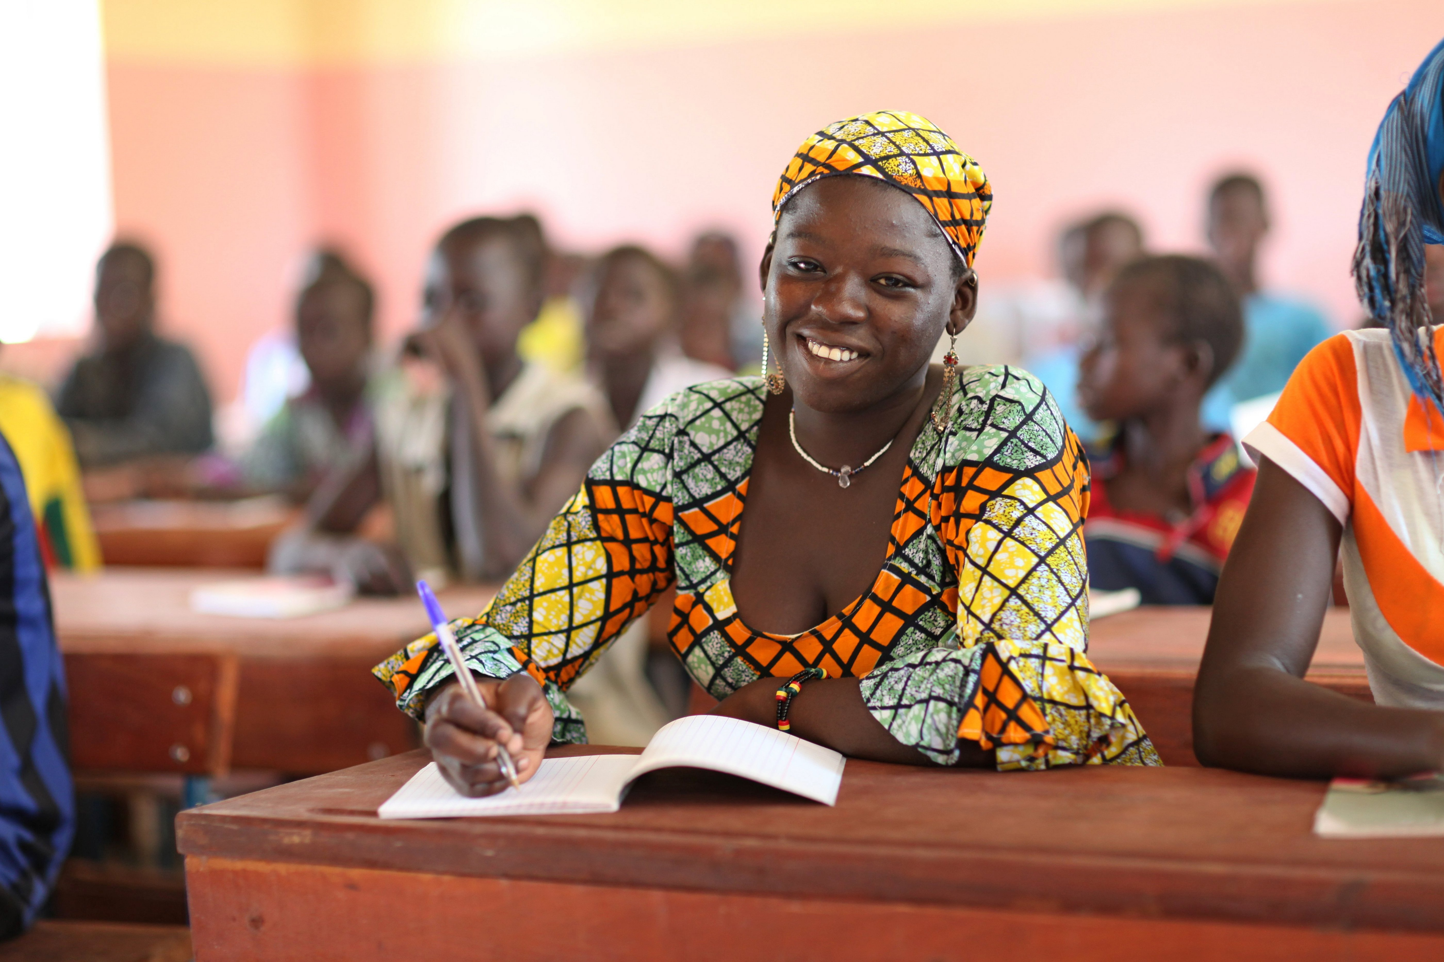
Comment vous sentez-vous?

Slide 18
Examples of Social Justice Activities used in 3 sections of FRE 121 (Elementary French I), Fall 2015 with the textbook Points de départ by Scullen, Pons, & Valdman
Chapitre 1: theme> family
Prévision: students look at Stromae’s Twitter and Instagram before coming to class and examine a brief article in French about his 2015 concert tour in Africa, and his last date in Rwanda in particular: students are asked to identify cognates and make assumptions about what they think the article might be saying.
In class: Use chapter vocabulary (adjectives to describe him physically, character adjectives based on how students imagine his personality.
Listen to Stromae’s Papaoutai, fill blanks in lyrics;
Brief discussion in English about genocide in Rwanda and Stromae’s father’s assassination. Links in PPT for further reading.
Social Justice Categories: problem posing, text analysis, individual experience investigation, reflection

Slide 19
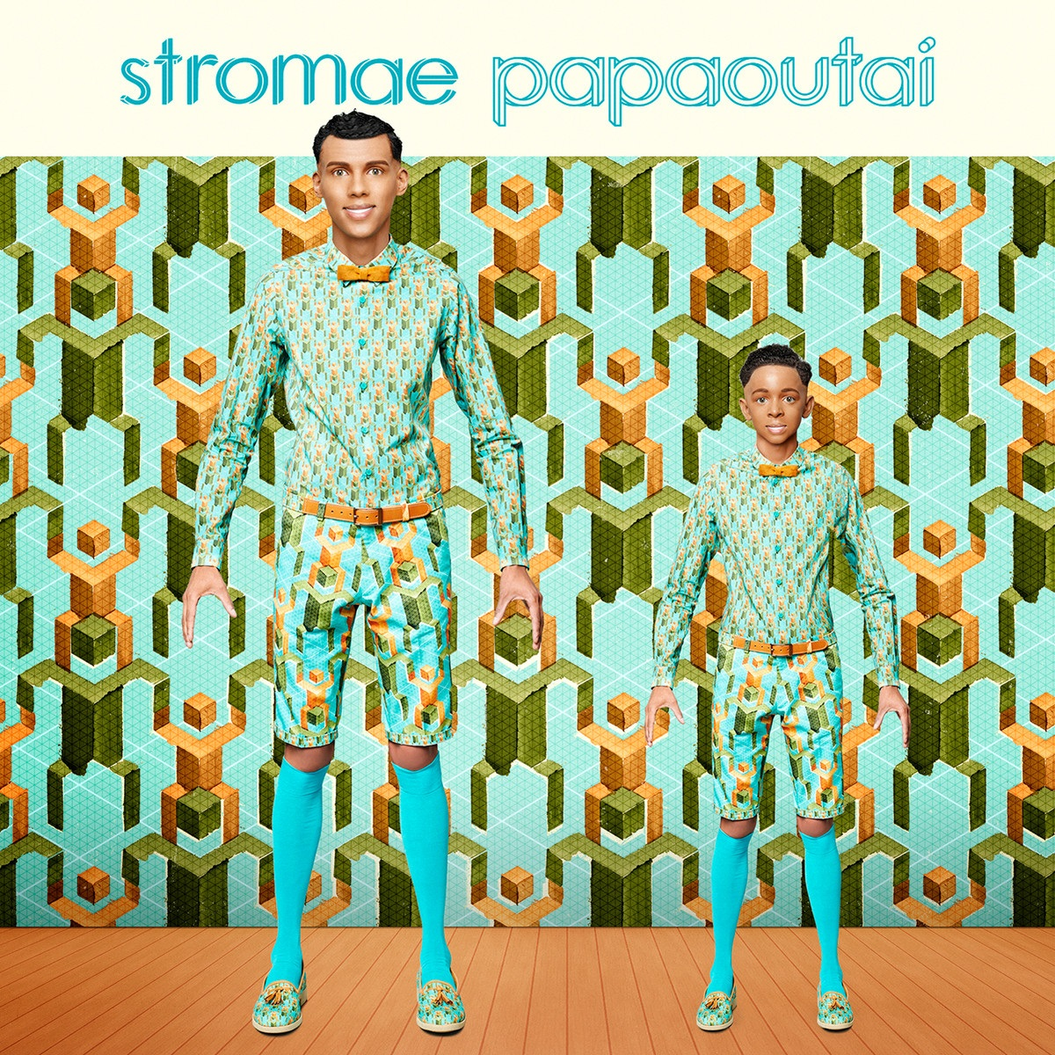
Stromae: Papaoutai

Slide 20
Examples of Social Justice Activities used in 3 sections of FRE 121 (Elementary French I), Fall 2015 with the textbook Points de départ by Scullen, Pons, & Valdman
Chapitre 2: friends and leisure time
Textbook activity on Les Misérables and adjectives/descriptions with added social justice context
Questions/Ideas for discussion in English
How do you feel about the homeless and the poor?
Who do you feel is responsible for their problems? Themselves? The government? Society in general? Why?
How do you think poor people feel about the way they are treated?
In Les Misérables, the beggars sing “When’s it going to end? When we gonna live? Something’s gotta happen now or something’s gonna give”; what do they mean by this?
In the story of Les Misérables, what reforms do you think Victor Hugo might be indirectly or directly advocating to fight social injustice?

Slide 21
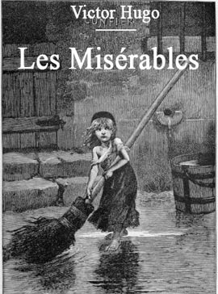
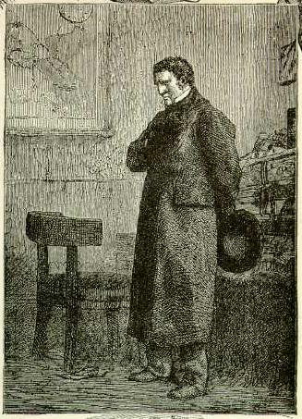
Les Misérables

Slide 23
Discussion of excerpt from the textbook with accompanying activities

Slide 24
Examples of Social Justice Activities used in 3 sections of FRE 121 (Elementary French I), Fall 2015 with the textbook Points de départ by Scullen, Pons, & Valdman
Ideas for longer reflection assignments/research assignments:
Hugo attempted to convince his audience that the poor and the outcast are worth saving. In our society, is this belief commonly held? Why or why not?
Explore the conditions under which most common people worked in Hugo’s time. What kinds of factory conditions were they forced to endure? How do they differ from conditions workers deal with today? Explore the influences of unions, child labor laws, environmental protection laws.
Social Justice Categories: problem posing, text analysis, rights and policy investigation, reflection

Slide 25
Examples of Social Justice Activities used in 3 sections of FRE 121 (Elementary French I), Fall 2015 with the textbook Points de départ by Scullen, Pons, & Valdman
Chapitre 3: Daily routines, places and fashion
Paris, je t’aime vignette viewings, Stuff Parisians Like vignette readings, intro to the headscarf ban in public schools in France, the burqa ban in France, race and ethnicity in France. Discussion in English.
Social Justice Categories: Problem-posing, textual analysis, rights and policy investigation, reflective

Slide 26
le mercredi 14 et le vendredi 16 octobre, nous allons…
Prononcer le vocabulaire sur les vêtements
Faire des compliments sur les vêtements
Discuter les vignettes de Stuff Parisians Like
Faire un défilé de mode (fashion show!)
Regarder quelques vignettes du film Paris, je t’aime
Discuter le voile (veil) en France
Rechercher (research) quelques figures importantes en France qui travaillent sur des causes diverses de la justice sociale

Slide 29
Examples of Social Justice Activities used in 3 sections of FRE 121 (Elementary French I), Fall 2015 with the textbook Points de départ by Scullen, Pons, & Valdman
Chapitre 4: vacation spots and cultural activities in places where French is spoken, passé composé
Diversity dialogs and social justice: intro to six French citizens using their art/position in society to make a difference; Students are assigned groups in which they will research and present one person in English. Issues broached in fall 2015: LGBT rights, race and slavery, poverty, immigration Francophone regions discussed: Algeria, French Guiana, Guadeloupe, Cameroun
Composition: genre>>letter Alternative break/service learning trip: Visit a francophone country, discuss activities and do research to briefly discuss a charitable organization associated with that country and why you’ve decided to support it
Social Justice Categories: Problem-posing, textual analysis, rights and policy investigation, reflective

Slide 34
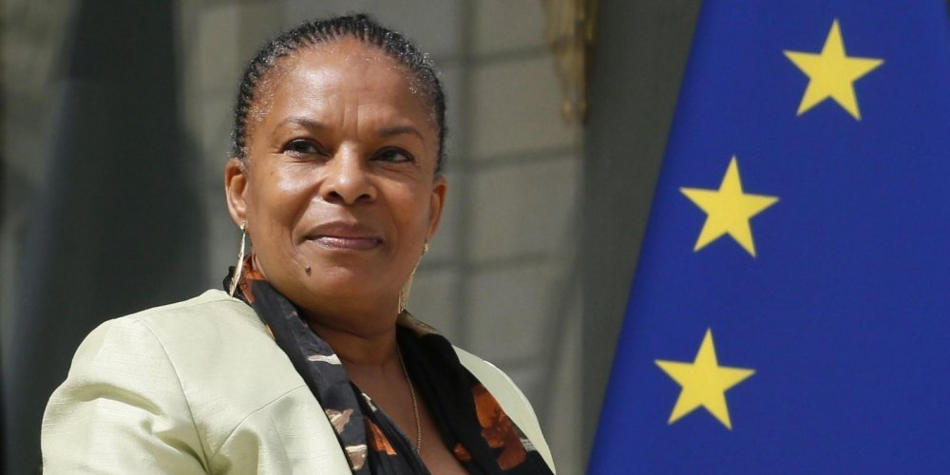
Posters in French using the passé composé
Azouz Begag…
Ses parents sont nés en Algérie.
Azouz est né en France.
Il a écrit beaucoup de livres.
Il a travaillé pour le gouvernement.
Il a été ministre.
Il a lutté contre le racisme.
Il a visité Elon.
Christiane Taubira…
Elle est née en Guyane française.
Elle a travaillé comme la présidente du parti Walwari.
Elle a travaillé dans le gouvernement français.
Elle a fait la loi Taubira.
Elle a lutté contre le racisme, le sexisme, et l’homophobie.

Slide 35
Composition in the past tense

Slide 36
Examples of Social Justice Activities used in 3 sections of FRE 121 (Elementary French I), Fall 2015 with the textbook Points de départ by Scullen, Pons, & Valdman
Chapitre 5: FOOD
Two readings: 1) ”Berthillon” from Dessine-moi un parisien d’Olivier Magny and 2) “Le temps des livres” from L’énigme du retour de Dany Laferrière to juxtapose luxury and excess/la vie gourmande with hunger in Haiti.
Reading, listening, viewing film version of “Déjeuner du matin” de Jacques Prévert to point out cultural assumptions about sexual orientation.
Social Justice Categories: Problem-posing, textual analysis, reflective

Slide 37
Examples of Social Justice Activities used in 3 sections of FRE 121 (Elementary French I), Fall 2015 with the textbook Points de départ by Scullen, Pons, & Valdman

Slide 38
petite activité de compréhension

Slide 39
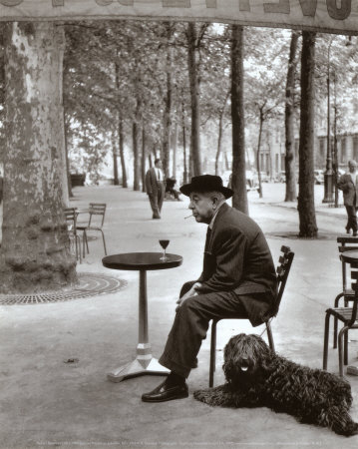
Déjeuner du matin
Jacques Prévert
Activité 1 → Regardez un court métrage (short film) basé sur le poème et écrivez quelques phrases au passé pour illustrer l’action de l’histoire.
Activité 2 → Remplissez les blancs du poème avec lesverbes au passé composé, faisant attention aux verbes irréguliers, aux verbes auxiliaires, et aux accords (agreements).
Activité 3 → Discussion du poème en groupes.
Activité 4 → Lisez le poème avec un bon accent.

Slide 40
Déjeuner du matin
Il a mis le café Dans la tasse Il a mis le lait Dans la tasse de café Il a mis le sucre Dans le café au lait Avec la petite cuiller Il a tourné Il a bu le café au lait Et il a reposé la tasse Sans me parler .
Il a allumé Une cigarette Il a fait des ronds Avec la fumée Il a mis les cendres Dans le cendrier Sans me parler Sans me regarder
Il s’est levé Il a mis Son chapeau sur sa tête Il a mis Son manteau de pluie Parce qu’il pleuvait Et il est parti Sous la pluie Sans une parole Sans me regarder
Et moi j’ai pris Ma tête dans ma main Et j’ai pleuré.

Slide 41
Réfléchissons…
5 minutes de discussion en groupes de 3
Qui est le narrateur du poème?
C’est un homme? Une femme?
Quelle relation est-ce que le narrateur a avec l’autre personne?
Qu’est-ce qui s’est passé avant les événements du poème?
Qu’est-ce que vous imaginez va se passer après?

Slide 42
Common sound patterns in the poem
* Rappel – la dernière consonne du mot est d’habitude muette (silent)
an/en sounds like on (if you say it holding your nose!)
ui sounds like wii
er/é sounds like ay
au/eau sounds like oh
eu sounds like er
oi sounds like wah
ain sounds like an (if you say it holding your nose!)
Maintenant chaque étudiant va lire un vers du poème.

Slide 43
And sometimes you have to be spontaneous…
Terrorist attacks in Beirut and Paris on November 12 & 13, 2015
Discussion of injustice in the media regarding coverage of the attack in Beirut and other middle eastern and African nations
Discussion of Lebanon as a Francophone country/its relationship to France
Racial profiling of Arabs and Muslims in France and the US
Students wrote messages of hope and peace to share
New vocabulary: l’espoir, prier, etc.

Slide 45
Student reactions
“The social justice aspect made learning French feel more relevant. I feel like I have a better, less stereotypical view of France after this class.”
“I was shocked at how much French we learned . . . I really loved how you made class relevant to what was going on in the world . . . I loved the social justice component. This class was very rewarding overall.”
“The cultural component was the best. I loved our discussion on the 2 readings [“Berthillon” & “Le temps des livres”]. This was very cool and fostered critical thinking. I learned SO much French!”
“I have enjoyed your class immensely, in particular the focus of French culture and social justice.”

Slide 46
Student reactions
“I really enjoyed the social justice and culture aspect of the class. I think it enhanced my experience and knowledge of French. It also made class more interesting and real.”

Slide 47
Student reactions
“Learning about not only French culture but also social justice in France gave me motivation to excel in French. Now having the ability to speak about important topics in French has made me a more confident learner and speaker.”
“I really enjoyed learning about the social justice issues in Francophone countries. When doing the projects about specific people, it was nice to learn about them in English because I actually fully understood who they are.”
“I liked learning about individuals who made an impact in France. It was interesting to see how they were similar and different from our celebrities.”
“I very much appreciated the social awareness activities. I enjoyed making the posters after the attacks on Paris and feeling like I contributed a little.”

Slide 48
USEFUL SOURCES

Slide 49
Critical Bibliography
Adams, M., L.A. Bell, & P. Griffin, eds. (2007). Teaching for Diversity and Social Justice. New York: Routledge.
Andrzejewski, J., M. Baltodano, & L. Symcox, eds. (2009). Social Justice, Peace, and Environmental Education: Transformative Standards. New York: Routledge.
Apple, M. (2013). Can Education Change Society? New York: Routledge.
Banks, J. A. (2004). Teaching for Social Justice, Diversity, and Citizenship in a Global World. The Educational Forum, 68(4), 296-305.
Chapman, T. K. & N. Hobbel, eds. (2010). Social Justice and Pedagogy Across the Curriculum: The Practice of Freedom. New York: Routledge.
Chubbuck, S. M. & M. Zembylas. (2008). The Emotional Ambivalence of Socially Just Teaching: A Case Study of a Novice Urban Schoolteacher. American Educational Research Journal, 45(2), 274-318.
Cross, R. (2010). Language Teaching as Sociocultural Activity: Rethinking Language Teacher Practice. The Modern Language Journal, 94(3), 434-452. Retrieved from http://www.jstor.org/stable/40856177
Ens, C. Z. & A. L. Sinacore, eds. (2005). Teaching and Social Justice: Integrating Multicultural and Feminist Theories in the Classroom. Washington, DC: American Psychological Association.
Glynn, C., P. Wesely, & B. Wassell. (2014). Words and Actions: Teaching Languages Through the Lens of Social Justice. Alexandria, Va: ACTFL.
Huber-Warring, T. (2008). Growing a soul for social change: building the knowledge base for social justice. Charlotte, NC: Information Age Publishing, Inc.
Mcknight, D. & P. Chandler. (2012). The Complicated Conversation of Class and Race in Social and Curricular Analysis: An examination of Pierre Bourdieu's interpretative framework in relation to race. Educational Philosophy & Theory. 44: 74-97.
Nieto, S. (2010). Language, culture, and teaching: Critical perspectives. New York: Routledge.
Osborn, T. A. (2005). Teaching World Languages for Social Justice: A Sourcebook of Principles and Practices. New York: Routledge.
---. (2005). Critical Reflection and the Foreign Language Classroom. Charlotte, NC: Information Age Publishing, Inc.
Phillips, J. K. & Abbott, M. (2011). A decade of foreign language standards: Impact, influence, and future directions. Retrieved from http://www.actfl.org/sites/defaults/files/pdfs/public/national-standards-2011.pdf
Smith, D. I. & T. Osborn, eds. (2007). Spirituality, Social Justice, and Language Learning. Charlotte, NC: Information Age Publishing, Inc.
Swalwell, K. (2013). Educating activist allies: Social justice pedagogy with the suburban and urban elite. New York: Routledge.

Slide 50
merci beaucoup! Partages? Questions? Idées?
Sarah Glasco
sglasco@elon.edu

